Slide 1
WESTERN CAPE PROVINCIAL PARLIAMENT
URGENT CALL FOR SPEED RESTRICTIONS ON THE R44
THROUGH BETTY’S BAY
Addressing Lawless Speeding, Human Safety Hazards, and Wildlife Fatalities through Betty's Bay within the UNESCO declared Kogelberg Biosphere)

Slide 2
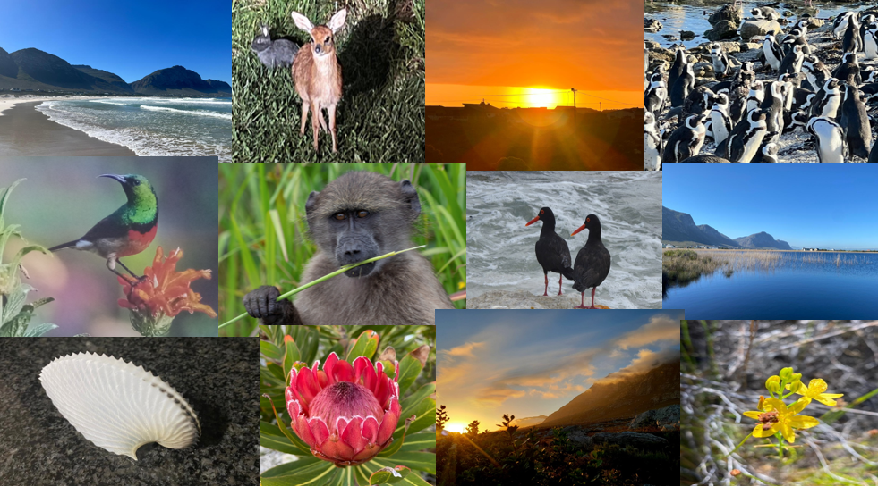

Slide 3
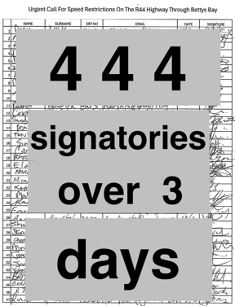
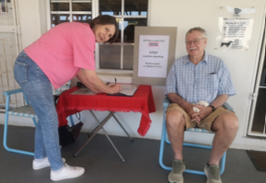
CONSTITUTIONAL BASIS AND CONTEXT
1. Constitutional Mandate
Submitted under Section 115(d) of the Constitution of South Africa (1996), Section 23(f) of the Western Cape Constitution, and Standing Rule 91(e).
Serves as a formal constitutional instrument of public participation under Section 17, backed by 444 wet-ink signatures collected from local residents and stakeholders in three days.

Slide 4
CONSTITUTIONAL BASIS AND CONTEXT
2. The R44 highway
It extends through the full 10.5 km length of Betty's Bay, cutting directly through residential neighbourhoods and sensitive eco-tourism zones.
It was widened through Betty’s Bay, prior to the establishment of the Kogelberg Biosphere Reserve in 1998. This was to accommodate heavy vehicles destined for the construction of the Denel site and the proposed rocket launch pad. The wider than average dimensions of the road, and its excellent surface conditions, provides unrestrained speedsters with the ability to reach unacceptable levels of speed and noise. They have turned this road into a dangerous racetrack, severe noise nuisance, and ecological hazard.
Due to the 230 properties adjacent to the R44, who have direct access onto it, together with 37 intersections, our research shows that it qualifies as a Class 3 Arterial road requiring speed reduction with automated cameras and calming measures such a mini-roundabouts and speed humps

Slide 5
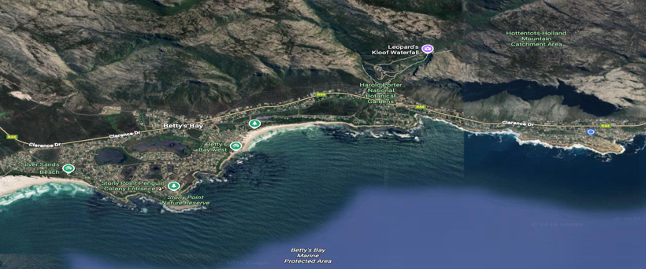
CORE CONCERNS ACROSS BETTY'S BAY
1. Public Safety Risk
Approximately 230 residential driveways and 37 side roads intersect the R44 along the 10.5 km span, many at blind curves and steep rises.

Slide 6
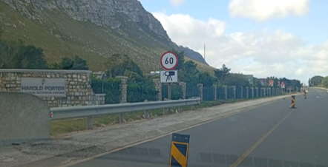
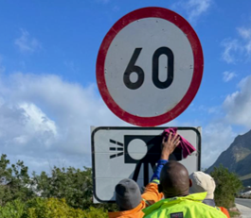
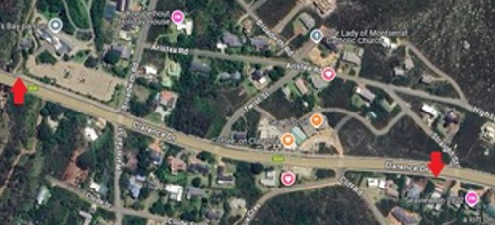
2. Ineffective Interventions
The 60 km/h camera zone installed at "The HUB" in July 2025 remains non-operational and fails legal distance & coverage requirements

Slide 7
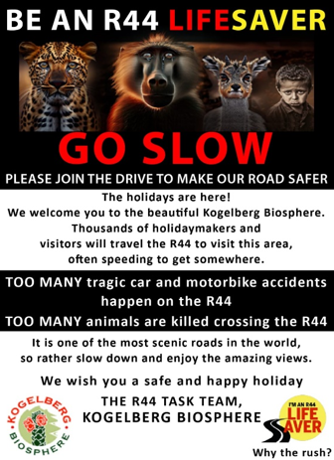
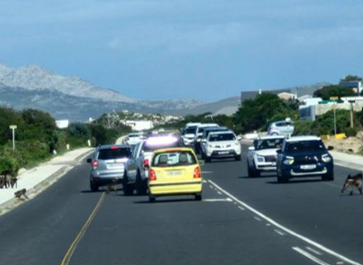
3. Ecological Destruction
The highway severs vital migration corridors inside the UNESCO Kogelberg Biosphere, creating unsustainable roadkill numbers.

Slide 8
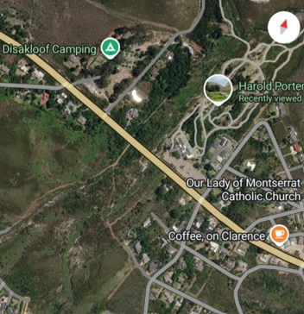
INFRASTRUCTURE AND TRAFFIC HAZARDS
1. Speed Physics & Risk: Doubling speed quadruples kinetic impact energy. Unenforced 80 km/h limits lead to frequent near-misses and severe side-impact collisions at concealed driveways.
2. High Density Access Points: Key facilities directly adjacent to the high-speed highway include the CBD Centre, Disa Youth Camp, Harold Porter Botanical Gardens, and "The HUB".

Slide 9
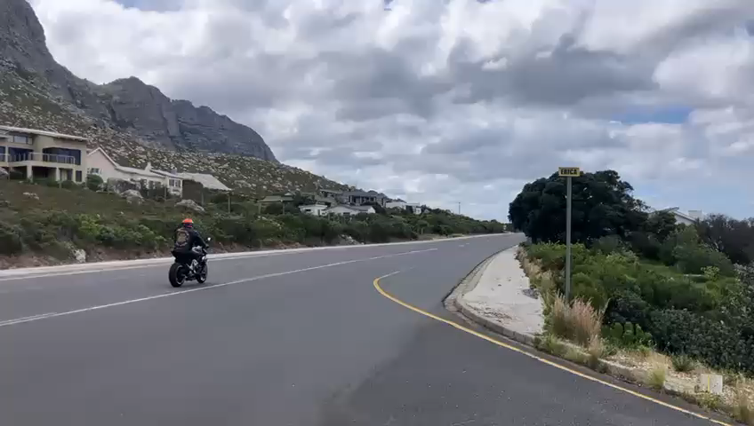
INFRASTRUCTURE AND TRAFFIC HAZARDS
3. Weekend Recklessness:
Motorists and motorcyclists exploit long open stretches, endangering pedestrians at school bus stops, taxi pickup spots, and Saturday Parkrun events.

Slide 10
PROPOSED ISSUES AND SOLUTIONS
AT SPECIFIC SITES ON THE R44 THROUGH BETTY’S BAY

Slide 11
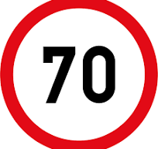
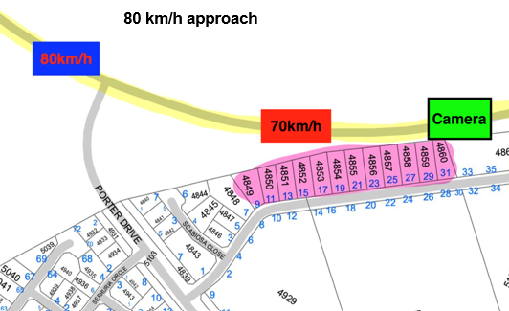
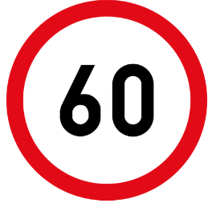
Uniform Speed Limit:
Lower main highway speed limit from 80 km/h to 70 km/h across the 10.5 km span, maintaining 60 km/h at "The HUB" and an 80 km/h 1km entrance transition.
80 km/h approach
70 km/h over 10.5 km
Retain 60 km/h at the HUB

Slide 12
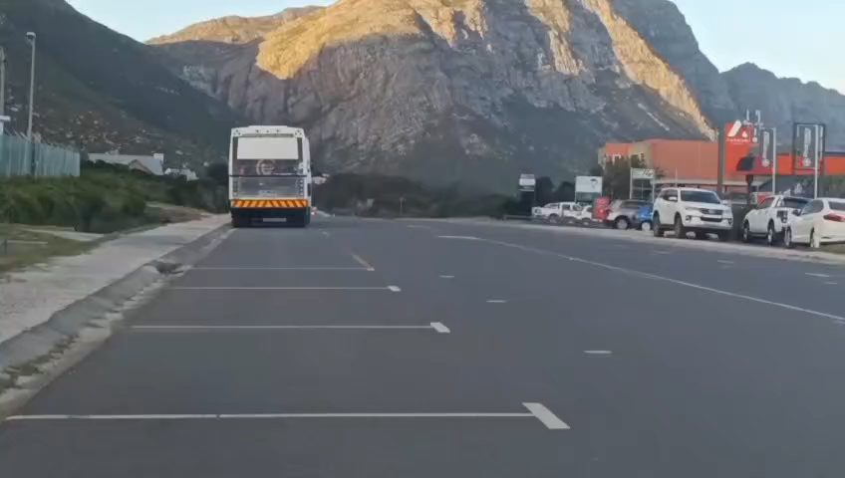
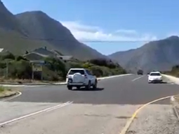
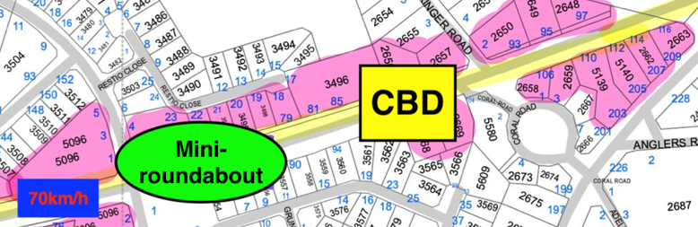
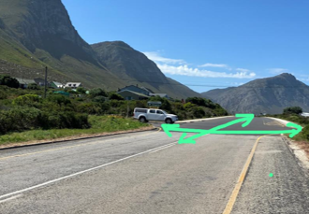
2. Disa Circle Mini-Roundabout:
Construct a mini-roundabout at the R44 / Disa Circle intersection to manage high commercial/residential traffic and secure school bus drop-off points.

Slide 13
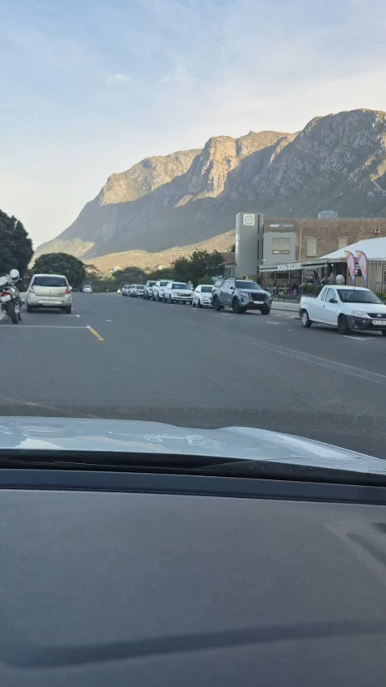
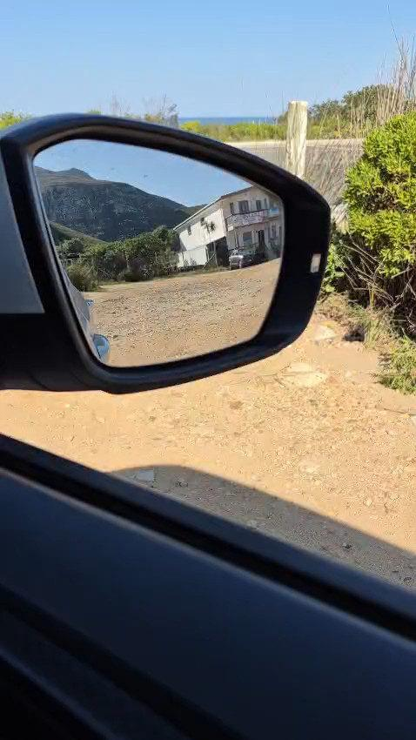
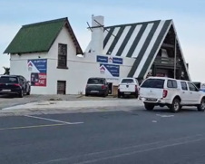
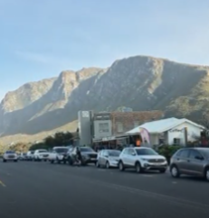
3. HUB Traffic Area:

Slide 14
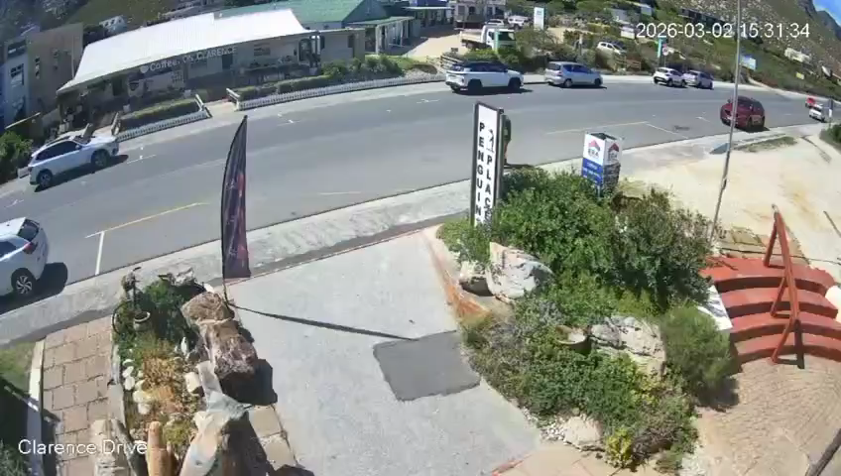
3. HUB Traffic Area:

Slide 15
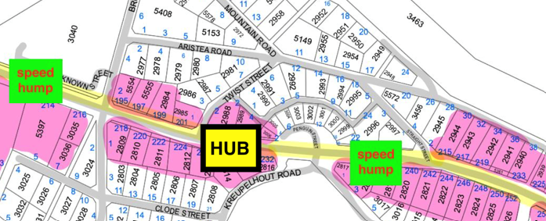
3. HUB Traffic Calming:
Install physical speed humps on both sides of "The HUB" commercial precinct to force speed compliance and safeguard pedestrians.

Slide 16
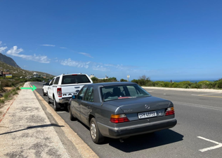
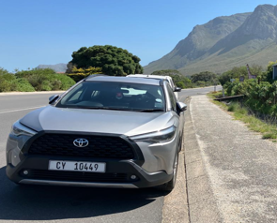
4. Hazardous Parking Removal: The HUB
Enforce National Road Traffic Act Regulations 304 & 305 by removing sight-blocking parking bays at "The HUB" and Sea View Link turnoff in Sunny Seas.

Slide 17
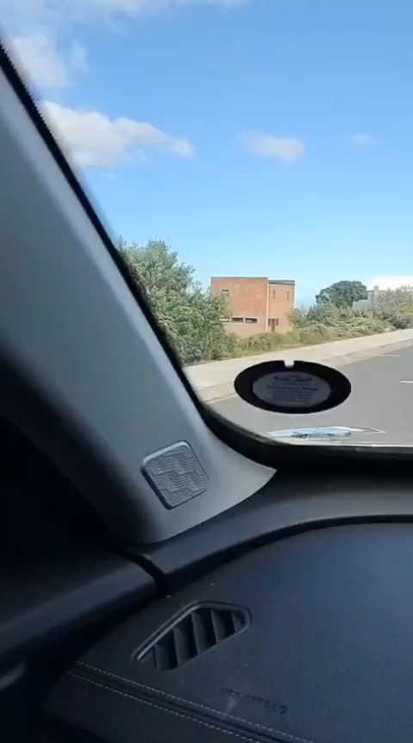
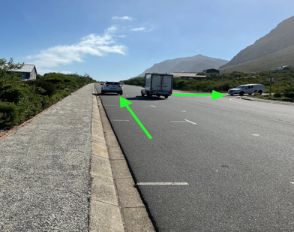
4. Hazardous Parking Removal:
Sea View Link turnoff in Sunny Seas
Enforce National Road Traffic Act Regulations 304 & 305
by removing sight-blocking parking bays at "The HUB"
and Sea Link turnoff.

Slide 18
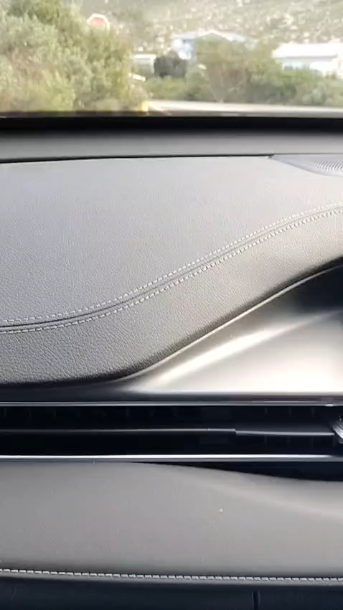
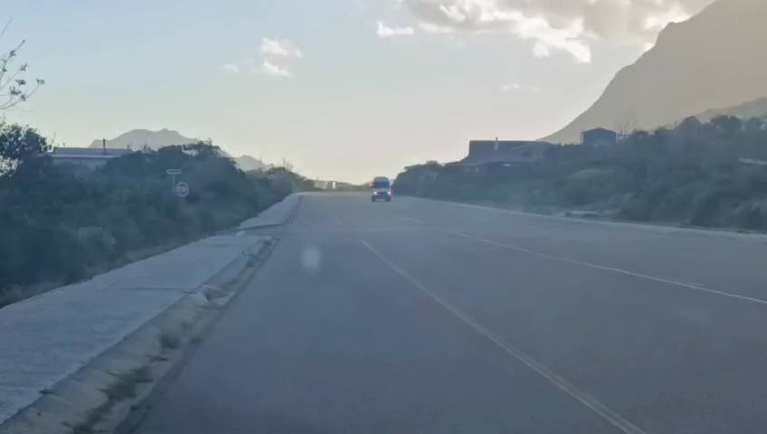
4. Luckhoff turnoff into Clarence:
Entry: Incline, slow entry and poor visibility onto Clarence Drive
Exit: Unsafe to turn off 80 km/h Clarence Drive

Slide 19
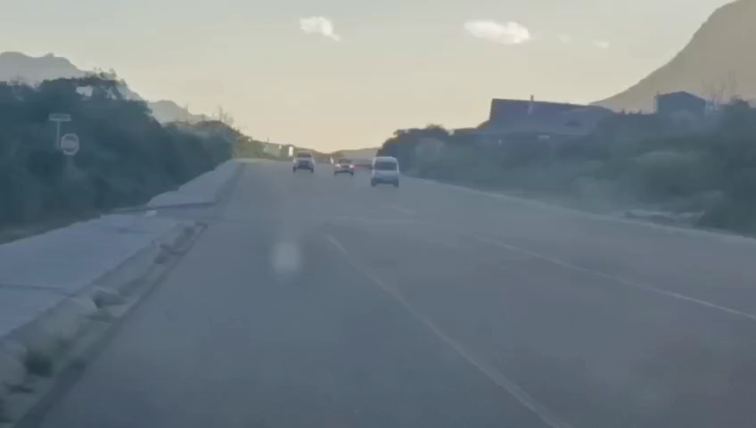
4. Luckhoff and Sea View Link area
Overtaking on the long straight “race area”

Slide 20
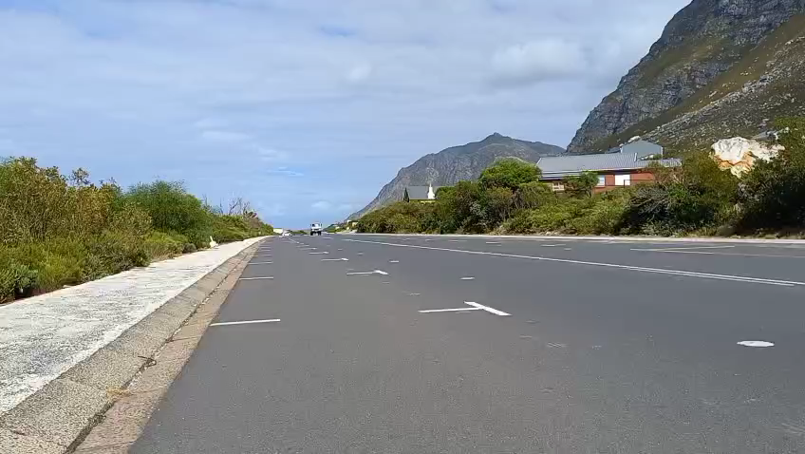
4. Luckhoff and Sea View Link area
Speeding tanker

Slide 21
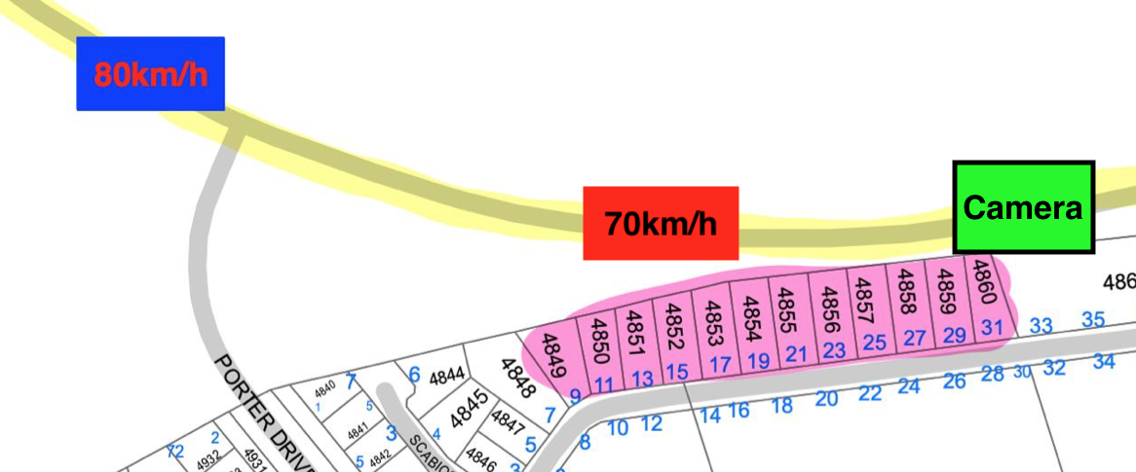
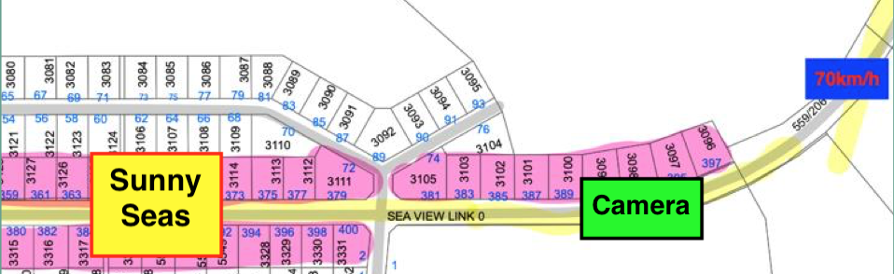
ENFORCEMENT AND BIOSPHERE MEASURES
5. Dual-Lane Speed Cameras
Deploy operational speed cameras at Eastern entrance (midway Porter Dr/Disa Circle) and Western Sunny Seas (before Luckhoff Rd).
Sunny Seas - to/from Kleinmond
Midway between Porter Drive and Disa Circle

Slide 22
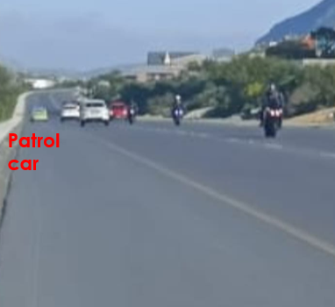
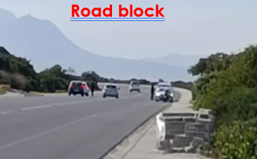
ENFORCEMENT AND BIOSPHERE MEASURES
6. Patrols and Roadblocks
Establish visible traffic officer presence and regular roadblocks on weekends to deter speeding bikers and strictly inspect illegal/obscured vehicle and motorcycle license plates.

Slide 23
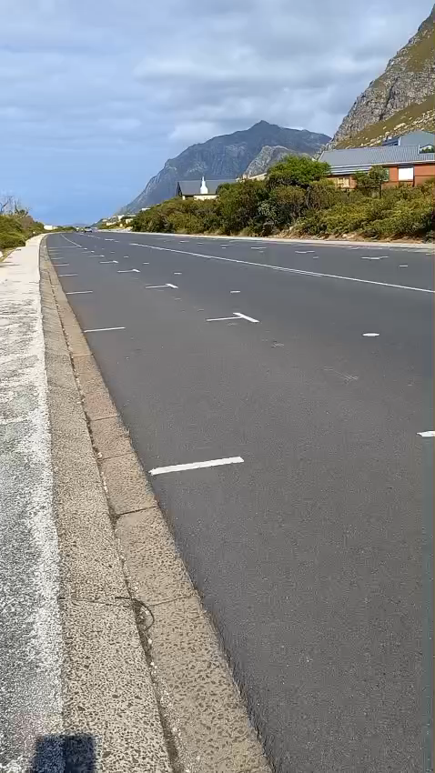
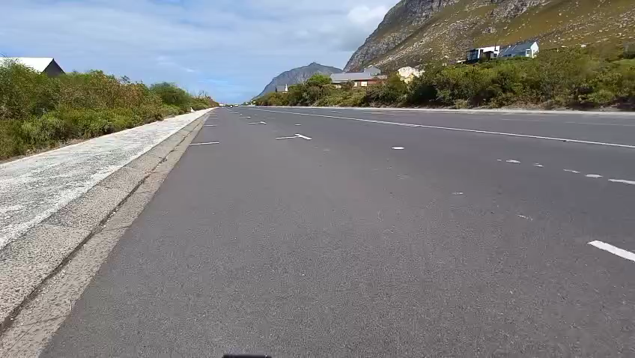
Speeding Shoprite bikers in Sunny Seas

Slide 24
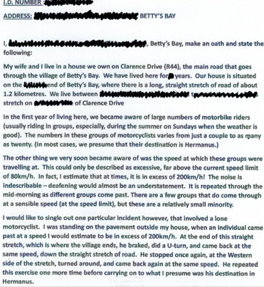
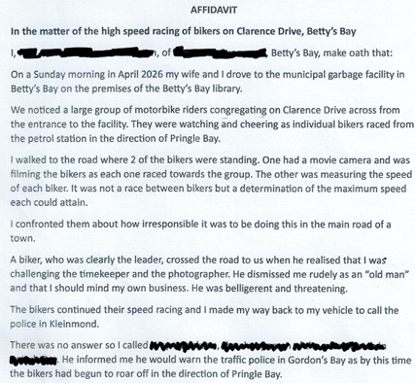
AFFIDAVITS ON BIKER BEHAVIOUR

Slide 25
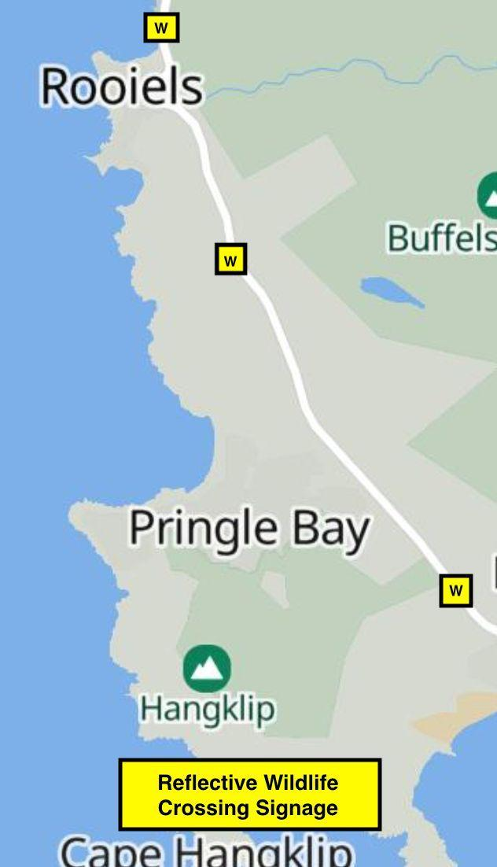
ENFORCEMENT AND BIOSPHERE MEASURES
7. Wildlife Crossing Signs
In order to uphold the ethical obligations within a UNESCO site, and ensure the ecological preservation of the Kogelberg Biosphere, the installation of reflective “Wildlife Crossings” signage is required along the R44 highway between Rooiels and including Betty’s Bay to alert drivers

Slide 26
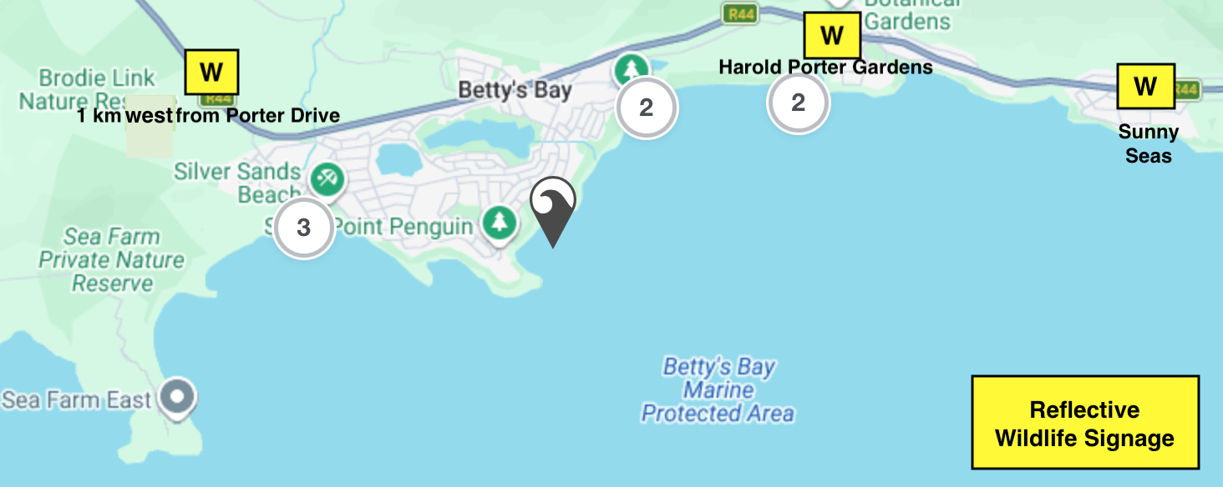
7. Wildlife signs within Betty’s Bay

Slide 27
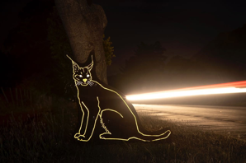
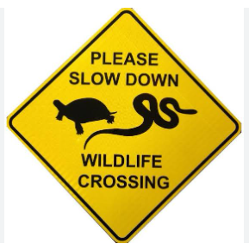
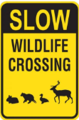
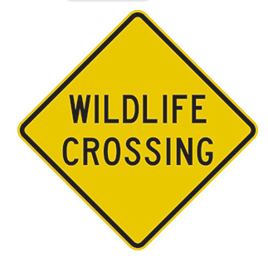
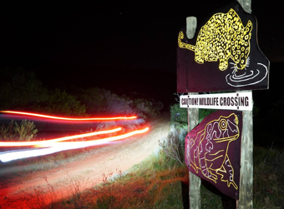
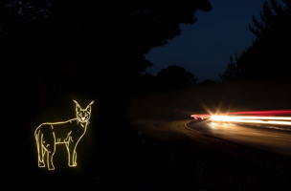
ENFORCEMENT AND BIOSPHERE MEASURES
7. Example of signs

Slide 28
ACCIDENT AND WILDLIFE FATALITIES

Slide 29
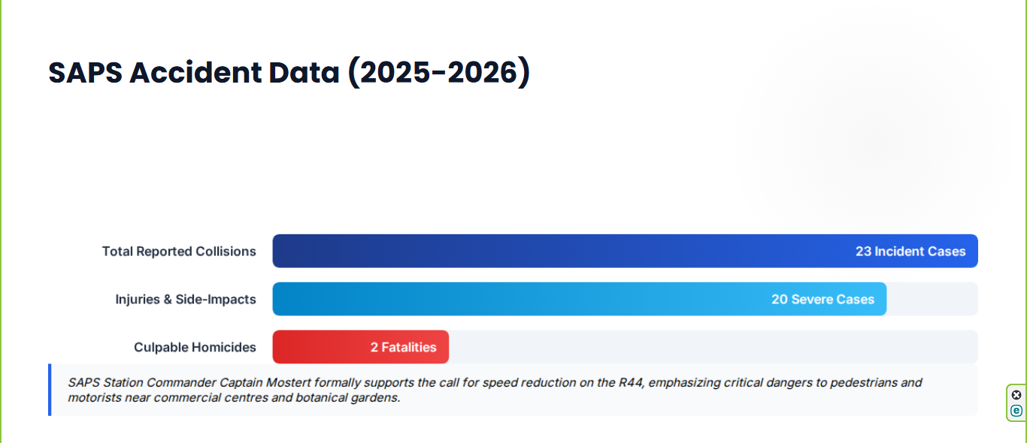
SAPS ACCIDENT DATA (2025-2026)
UPDATED DATA: NOW A TOTAL OF 28 ACCIDENTS IN 16 MONTHS
Multiple injuries including four serious injuries and two fatalities

Slide 30
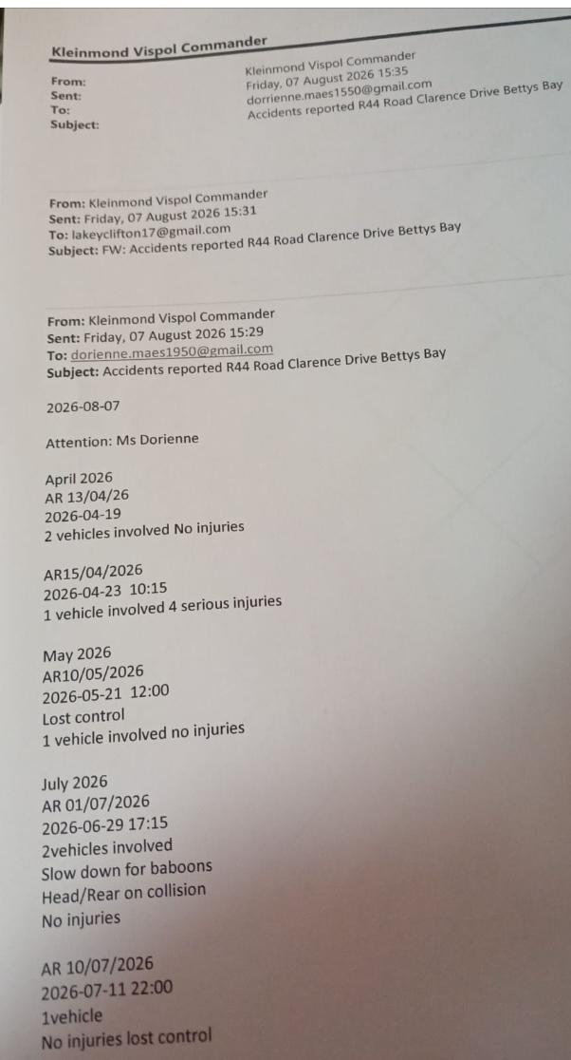


Slide 31



WILDLIFE MORTALITY CRISIS
Biosphere Devastation
The Kogelberg Biosphere Wildlife Rescue Centre recorded over 420 wildlife admissions in a single year, with 56 confirmed roadkill deaths (Feb 2023 – Feb 2026).
Species Affected: Spotted Eagle Owls, Cape Angulate Tortoises, Klipspringer,
Cape Clawless Otters, Genets, Porcupines, Mongooses, and Rock Hyraxes.

Slide 32

Wildlife death on the roads is one of the less visible conservation challenges facing our biosphere.
Since the start of 2026, the Kogelberg Biosphere Wildlife Rescue and Training Centre has recorded 25 roadkill incidents in the Kogelberg Biosphere on roads including the R44 and R43.
4 porcupines
3 grysbok
3 spotted eagle owls
3 caracals
2 tortoises
And several other species that call the biosphere home.
Motorists need to slow down, keep alert, and take extra care when driving at dawn and dusk. Reflective signage will help.
Note: Official figures represent a fraction of actual losses as baboons and unrecovered casualties are uncounted.

Slide 33


Slide 34
CONCLUSION

Slide 35

TIMELINE OF INACTION AND ESCALATION

Slide 36

REQUESTED PARLIAMENTARY ACTION
Immediate leadership required from WCPP and Provincial Executive to prevent further loss of human life and ecological destruction.

Slide 37
CONCLUDING THOUGHTS
The residents of Betty's Bay thank the Standing Committee on Mobility and trust that our concerns and solutions regarding lawless speeding along the R44 through Betty's Bay will be addressed in accordance with the opinions previously expressed by Minister Sileku.
"A change in behaviour of lawless drivers requires a shift in mindset alongside strict law enforcement. Punitive measures like fines and roadblocks are not enough on their own without personal accountability. Excessive speed significantly reduces a driver's reaction time, increases the severity of collisions and diminishes the effectiveness of safety measures in vehicles."

Slide 38


THANK YOU

